Slide 1


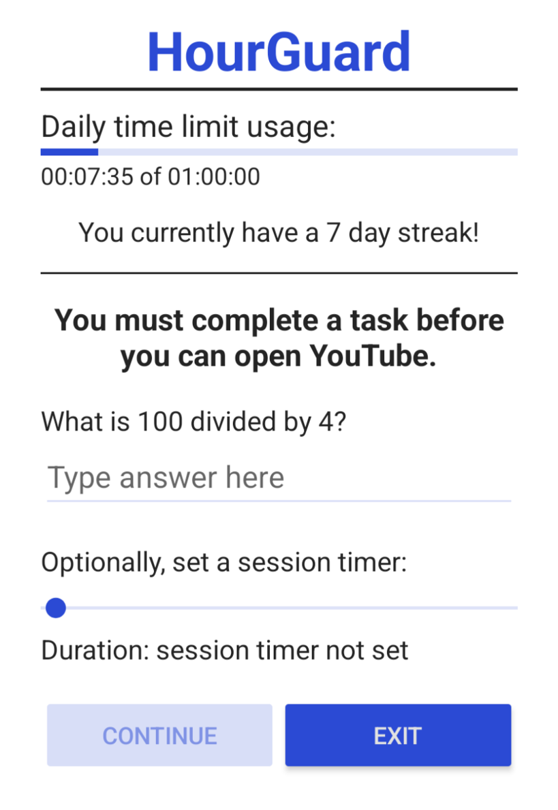
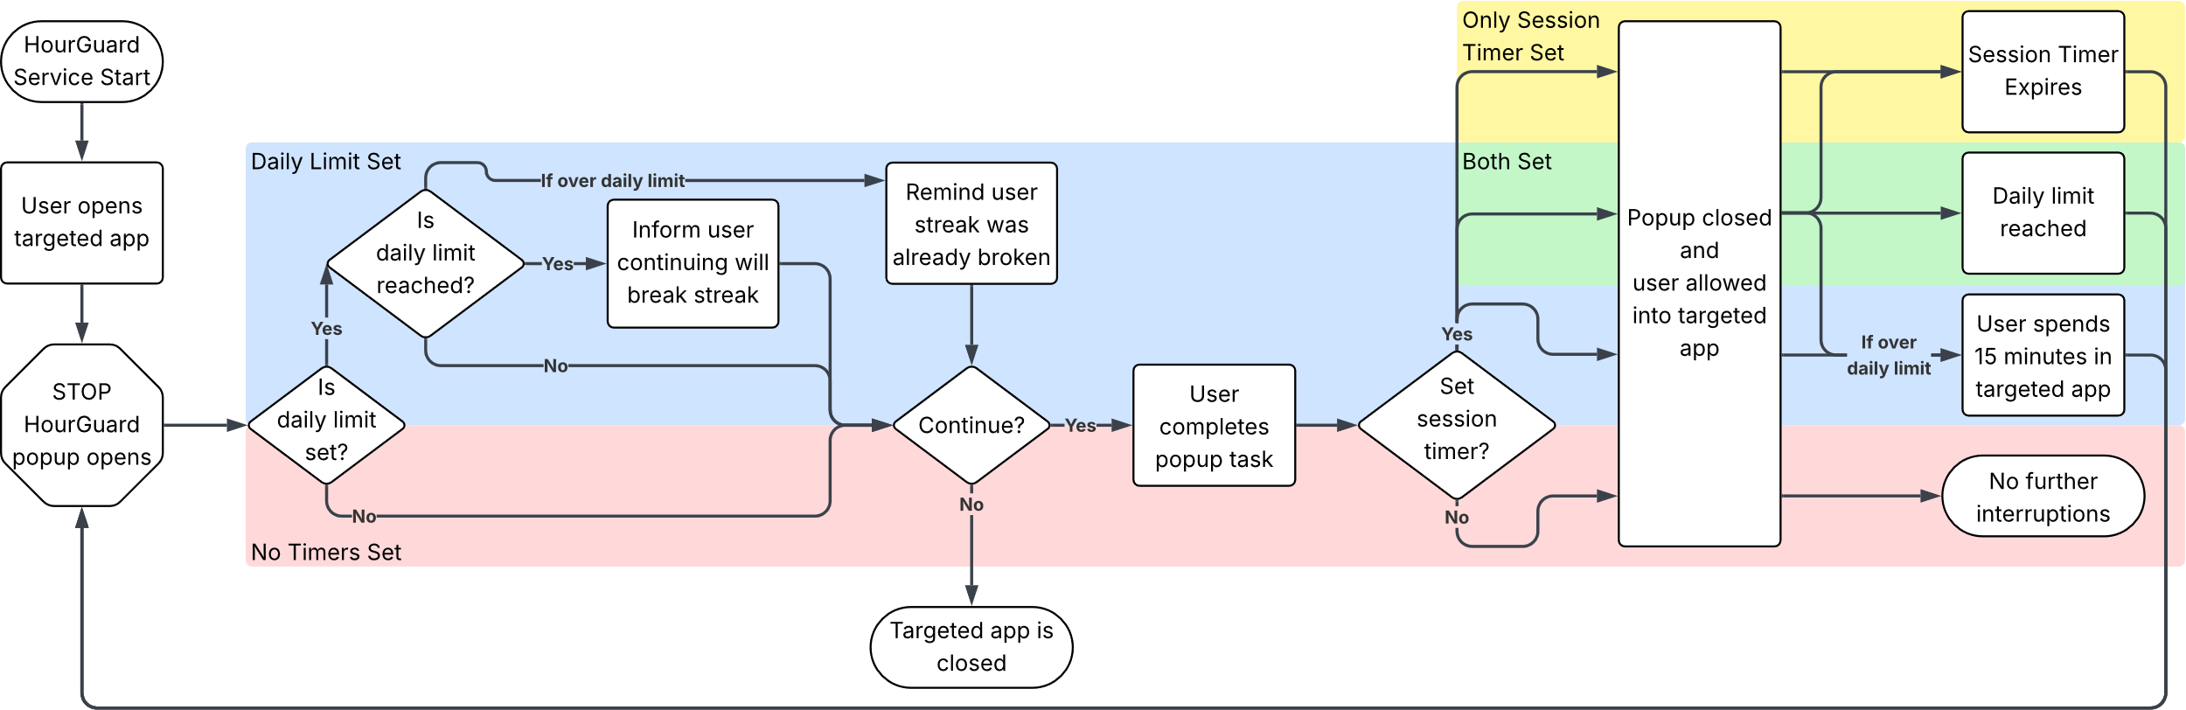



Team 4: Nicholas Dumford, Bobby Fechtel, Chase Smith
Advisor: Dr. Shane Halse
College of Education, Criminal Justice, and Human Services
HourGuard
The Problem
Our Solution
Cell phones are distracting and constantly begging for attention
Social media apps are especially addicting, designed to keep you on them as long as possible
Current solutions are primarily designed for parents
Flexible App Limits
Set daily limits, per-session timers, or both
Prevents Habituation
Thoughtful deterrence tasks prevent mindlessly opening addictive apps
About HourGuard
Track Progress
HourGuard is a psychology-backed time management app for Android devices
Helps the user build healthy screen time habits
Designed for self-regulation
Streaks for staying within set app limits provide positive reinforcement
How it Works
Activity Diagram
Technologies

